Slide 1
Deep Object Detection Methods: Benchmarking and Sensitivity Analysis
D
By: Daniel Griffin, Yudhister Satija

Slide 2
Outline
Background
What are we trying to solve?
Why should you care?
State of the art?
Our Approach
Specifics
Models, transforms, systems, overall pipeline.
Results
Summary
Next Steps

Slide 3
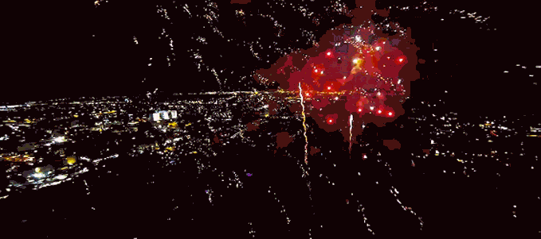
Deepnets

Slide 4
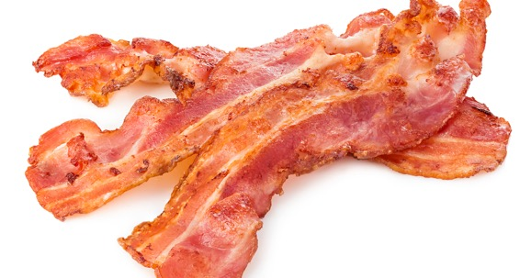
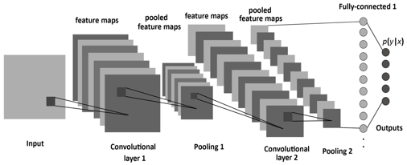
Deepnets are the new Bacon.
However, no one is really asking the question, How good is this Bacon?

Slide 5
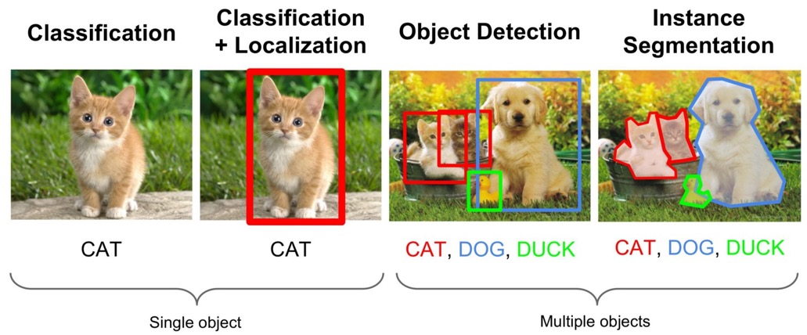
Background: The Problem

Slide 6
Object Classification Vs Region Proposal

Slide 7
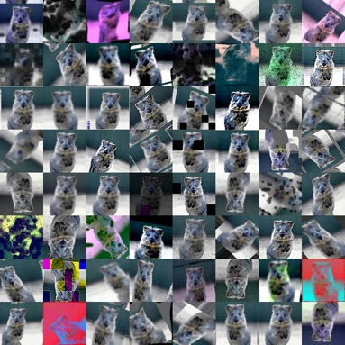
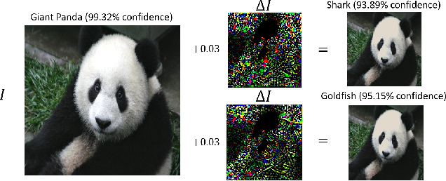
Variation in Images Is a Problem
Adverserial
Natural

Slide 8
What problems are we trying to solve?
How sensitive are cutting edge deep object detection networks to natural noise/errors/variation in images?
What kind of process and metrics should be used to quantify this sensitivity?
Can our analysis be used to provide a insight into which networks to use in different contexts?

Slide 9
Why is this problem important?
Y
Safety Applications
A practical understanding or methodology for determining how Deepnets fail is crucial if we expect to use deep nets in safety concerned applications, such as autonomous driving.
Context Specific Applications
Field focus is on “new” networks.
Little knowledge of practical use “in the wild”.
Lack of Rich Performance Metrics
Standard ML metrics don’t map very well to object detection.
There aren’t rich metrics that quantify things like “color sensitivity”

Slide 10
What is the current state-of-the-art?
Networks:
Mask R-CNN, RetinaNet, Faster R-CNN , RPN , Fast R-CNN , R-FCN, YOLO
Backbones: ResNeXt{50,101,152} , ResNet{50,101,152} , Feature Pyramid Networks , and VGG16
Datasets:
COCO (Multi-object Detection Dataset)
PASCAL VOC (Multi-object Detection Dataset))
Kitti (Autonomous Vehicle Object Detection Dataset)
Analysis:
Simple aggregated performance metrics
Adversarial based analysis

Slide 11
Our Approach
Benchmarking and Sensitivity Analysis:
Select most cutting edge networks.
Perform performance analysis on core images.
Generate images with “natural” errors/noise/variation.
Perform performance analysis on transformed images.
Compare/contrast performance to draw insights about deep network sensitivities across different network kinds.

Slide 12
The Specifics
Networks:
10 networks (Requires 11GB Graphics Cards)
<Net Arch>_<Net Backbone>-<Proposals>_2x
e2e_faster_rcnn_R-101-FPN_2x
e2e_faster_rcnn_R-50-C4_2x
e2e_faster_rcnn_R-50-FPN_2x
e2e_faster_rcnn_X-101-64x4d-FPN_2x
e2e_mask_rcnn_R-101-FPN_2x
e2e_mask_rcnn_R-50-C4_2x
e2e_mask_rcnn_R-50-FPN_2x
retinanet_R-101-FPN_2x
retinanet_R-50-FPN_2x
retinanet_X-101-64x4d-FPN_2x
Images:
COCO image validation data set.
5000 base images (600x800 3 channel images)
50 Transforms generating 250,000 images total
5000*50*10*(300 proposals/net) = 750 Million object candidates
Systems:
8 GTX 1080ti GPU system with 11GB per Card, 8 GB Ram
i7 CPU, 24GB Ram
Condor instances

Slide 13
Image Transforms (50 total)
Value Transforms:
Blur based
Region based
Color based
Lighting based
Spatial Transforms:
Scaling based
Orientation based
Translation based
Distortion based

Slide 14
Example Value Transforms
Super Pixels
Sharpen
Colorspace Hue
Intensity Multiply
Gaussian Blur
Contrast Normalize
Average Blur
Locality Shuffling

Slide 15
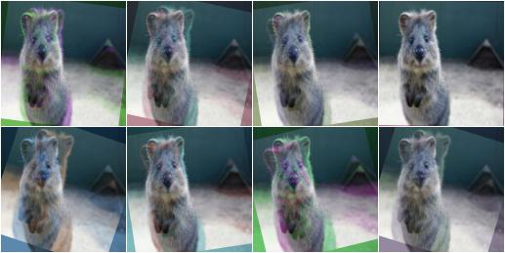
Example Spatial Transforms
Blend/Overlay
Scale
Flip L/R
Piecewise Affine
Flip U/D
Affine Scale

Slide 16
Our Pipeline (~4 Days)
Image Transformation
Object Detection
Analysis and Visualization
Understanding
GPU System
CPU System
CPU System
CPU System
Condor System

Slide 17
Results
Focus
Precision and Recall
Precision: How confident are we when the model predicts a dog, that the object is a dog, and not something else?
Recall: How many of the instances within a class are actually found?
Combinations
Model, Image Transform, Class

Slide 18
Results
D
Our Results
Over all (Model,Transform,Class)
Average Precision is around 0.53
Recall tends to be very low
Papers use “Mean Average Precision”
Paper Results Issues
Precision only
Unweighted Mean Average Precision
Class by class precision
Number washing

Slide 19
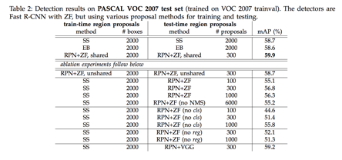
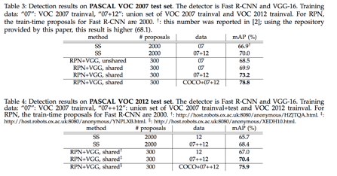
Results
MAP: Compute average precision (AP) separately for each class, then average over classes
Key Idea: Might be fine for comparing models given they are all evaluated on the same data set, but in terms of RAW, REAL WORLD performance, they should not be used.
Number Washing

Slide 20
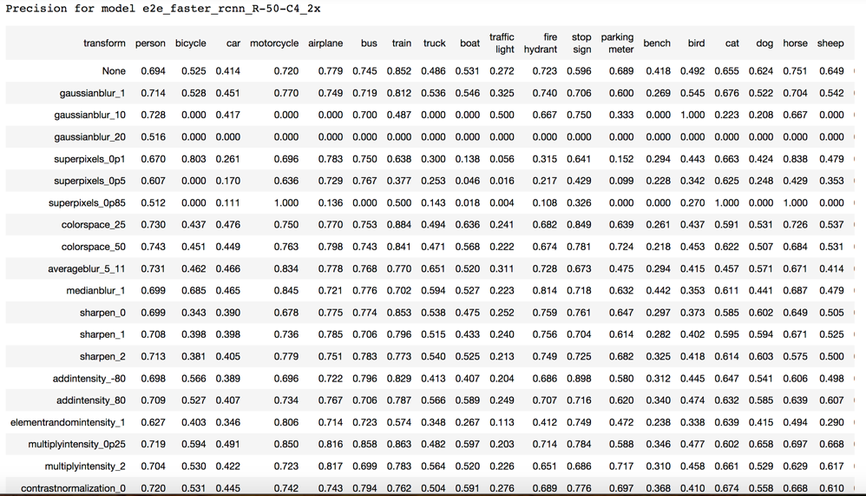
Results: Precision per (model,transform,class)

Slide 21
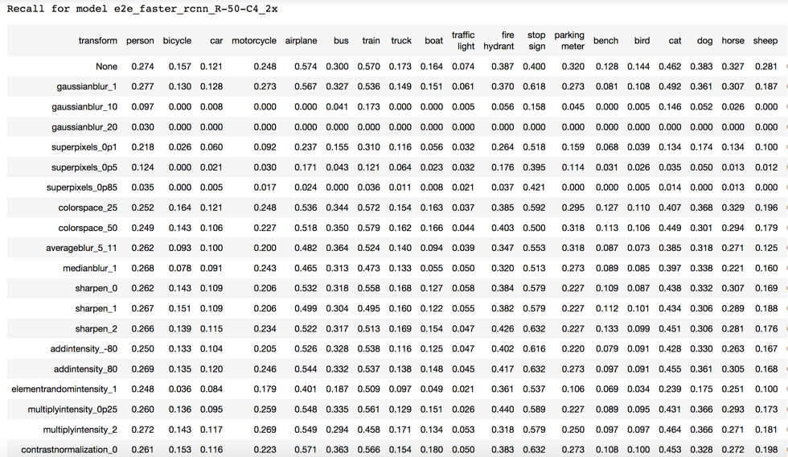
Results: Recall per (model,transform,class)

Slide 22
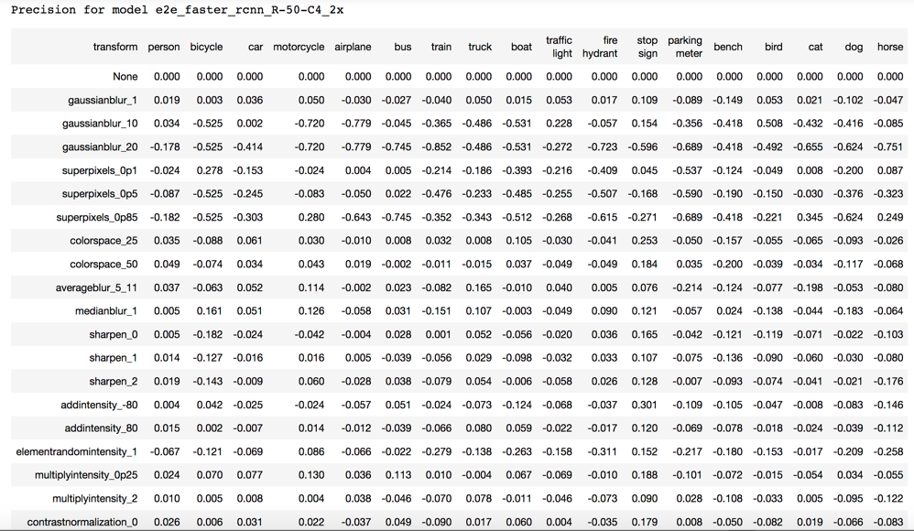
Results: Precision difference per (model,transform,class)
How much each transform affects precision?

Slide 23
Results: Precision per (class,transform) avg over model
Y
How much each transform affects precision a specific class, regardless of what model is used?

Slide 24
Results: Precision per (class,transform) avg over model
How much each transform affects precision a specific class, regardless of what model is used?

Slide 25
Results: Precision per (class,transform) avg over model

Slide 26
Results: Precision per (class,transform) avg over model

Slide 27
Results: Precision per (model) avg over transform and class
What models have better precision, no matter the class?
Can be used to compare against the metrics reported in papers.

Slide 28
Results: Recall per (model) avg over transform and class
What models have better recall, no matter the class?
Can be used to compare against the metrics reported in papers.

Slide 29
Results: Average precision difference given each transform category
What kind of variation affects each model the most on average?

Slide 30
The Short Summary
D

Slide 31
The Long Summary
What did we learn from doing this project?
Issues
Most networks are super brittle and need more work to make them robust.
Any image variation impacts performance.
Significant sensitivity to training image set.
Most evaluation metrics are average metrics.
Weighted average is disingenuous for performance across multiple classes.
There should be a diminishing marginal benefit performance metric.
Precision only (which most papers report) covers up low recall.
Recall IoU, only shows recall profile, not coupled recall and precision.
The way in which multi-class P/R averages are generated is not well specified.

Slide 32
The Long Summary Continued
What did we learn from doing this project?
Real World Guide
Blur
Well defined boundary objects (cars, trains, bus, bench, etc…) small blur is bad
Less well defined boundary objects, or moving objects with more variety (people, dogs, birds, etc…) small blur tends to be good.
Image size
Applications with large objects are better. In fact, if dealing with small objects, artificially scale image size to increase network performance.
Add contrast to your images.
Networks are very sensitive to the magnitude of relative intensity differences in images. Amplify these differences for improved performance.
Locality based jitter and noise is really bad.
Severely decreases performance. (Brownian motion type deal)
Center objects in images.
More centered objects are detected more often and more precisely than objects near edges.
Region textures matter in an object.
Superpixel transforms show degraded performance for larger contiguous regions with same color and no textures.
Hues and alternate color spaces
Adjusting hue values up increased performance on average. (Color contrasting affects)

Slide 33
(Recap) What problems are we trying to solve?
How sensitive are cutting edge deep object detection networks to natural noise/errors/variation in images?
What kind of process and metrics should be used to quantify this sensitivity?
Can our analysis be used to provide a insight into which networks to use in different contexts?

Slide 34
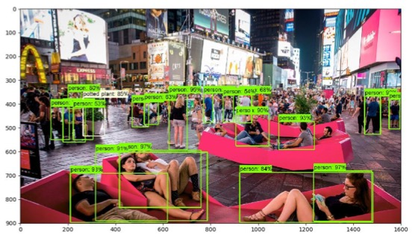
Project Next Steps
Y
Next Steps for This Project?
Sensitivity Analysis Toolkit.
New Sensitivity Metrics.
Next Steps for This Area?
Amount of re-training needed to reduce errors?
Architectural changes/constraints needed to reduce errors?
How much reducing network size for memory/speed affects errors?
Notes
Code on Github
4 days to run on our hardware (parallelize by 8)
4*8=32 days to run on single GPU single core system

